Slide 1
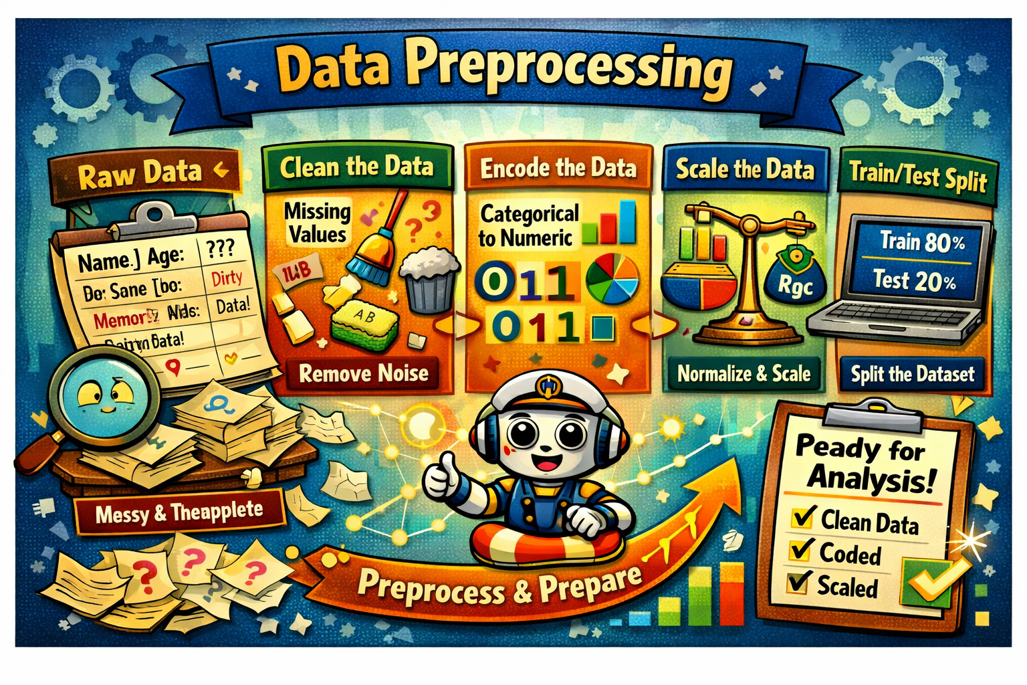
DATA PREPROCESSING FOR AL & ML
Dr Ashok Gopalakrishnan, Retired Scientist from NASA,
Recipient of the Prestigious International "Education 2.0 Conference Visionaries Award 2026”, DUBAI

Slide 2
DATA PREPROCESSING FOR AL & ML
Real-world data is often incomplete, noisy, and inconsistent, which can lead to incorrect results if used directly. Data preprocessing in data mining is the process of cleaning and preparing raw data so it can be used effectively for analysis and model building.
Real data contains missing and incorrect values
Data may come from multiple sources
Large datasets often have irrelevant information
Clean data gives better mining results

Slide 3
DATA PREPROCESSING FOR AL & ML
Steps in Data Preprocessing
Some key steps in data preprocessing are:
1. Data Cleaning
It is the process of identifying and correcting errors or inconsistencies in the dataset. Its common tasks include:
Handling missing values
Removing duplicate records
Correcting wrong or inconsistent data
Handling Outliers
Example:
Replacing missing age values with the average age
Removing repeated rows in a dataset

Slide 4
DATA PREPROCESSING FOR AL & ML
Steps in Data Preprocessing
Some key steps in data preprocessing are:
2. Data Integration
It involves merging data from various sources into a single, unified dataset. It can be challenging due to differences in data formats, structures, and meanings.
Used when data comes from databases, files, or APIs
Removes redundancy between datasets
Resolves conflicts in data values
Example: Merging customer data from sales and marketing databases

Slide 5
DATA PREPROCESSING FOR AL & ML
Steps in Data Preprocessing
Some key steps in data preprocessing are:
3. Data Transformation
Data transformation converts data into a suitable form so that data mining algorithms can work effectively.
Bring data into a common format
Improve mining efficiency
Make data suitable for modeling
Example:
Converting salary values into a fixed range (0–1)
Changing text labels like Male/Female into numeric values

Slide 6
DATA PREPROCESSING FOR AL & ML
Steps in Data Preprocessing
Some key steps in data preprocessing are:
4. Data Reduction
It reduces the dataset's size while maintaining key information. This can be done through feature selection which chooses the most relevant features and feature extraction which transforms the data into a lower-dimensional space while preserving important details.
Improves processing speed
Saves storage space
Makes analysis easier

Slide 7
DATA PREPROCESSING FOR AL & ML
Benefits of Data Preprocessing
Improves data quality
Increases accuracy of mining results
Reduces errors in models
Makes data easier to understand
Advantages
Improved Data Quality: Ensures data is clean, consistent, and reliable for analysis.
Better Model Performance: Reduces noise and irrelevant data, leading to more accurate predictions and insights.
Efficient Data Analysis: Streamlines data for faster and easier processing.
Enhanced Decision-Making: Provides clear and well-organized data for better business decisions.

Slide 8
DATA PREPROCESSING FOR AL & ML
The quality of your data directly impacts the accuracy of your analysis and model performance. Why? Because raw data often contains inconsistencies, errors, and irrelevant information that can distort results and lead to flawed insights. Data preprocessing is a way to mitigate this problem. Namely, it is the process of transforming raw data into a clean, structured format.
Traditionally, data preprocessing has been an essential preliminary step in data analysis. However, more recently, these techniques have been adapted to train machine learning and AI models and make inferences from them.
Thus, data preprocessing may be defined as the process of converting raw data into a format that can be processed more efficiently and accurately in tasks such as:
Data analysis
Machine learning
Data science
AI

Slide 9
DATA PREPROCESSING FOR AL & ML
# Creating a manual dataset
data = pd.DataFrame({
'name': ['John', 'Jane', 'Jack', 'John', None],
'age': [28, 34, None, 28, 22],
'purchase_amount': [100.5, None, 85.3, 100.5, 50.0],
'date_of_purchase': ['2023/12/01', '2023/12/02', '2023/12/01', '2023/12/01', '2023/12/03']
})
# Handling missing values using mean imputation for 'age' and 'purchase_amount'
imputer = SimpleImputer(strategy='mean')
data[['age', 'purchase_amount']] = imputer.fit_transform(data[['age', 'purchase_amount']])
# Removing duplicate rows
data = data.drop_duplicates()
# Correcting inconsistent date formats
data['date_of_purchase'] = pd.to_datetime(data['date_of_purchase'], errors='coerce')
print(data)

Slide 10
DATA PREPROCESSING FOR AL & ML
Data integration
Data integration involves combining data from multiple sources to create a unified dataset. This is often necessary when data is collected from different source systems.
Some techniques used in data integration include:
Schema matching: Aligning fields and data structures from different sources to ensure consistency.
Data deduplication: Identifying and removing duplicate entries across multiple datasets.
For example, let’s say we have customer data from multiple databases. Here’s how we would merge it into a single view:
Next Slide please….

Slide 11
DATA PREPROCESSING FOR AL & ML
# Creating two manual datasets
data1 = pd.DataFrame({
'customer_id': [1, 2, 3],
'name': ['John', 'Jane', 'Jack'],
'age': [28, 34, 29]
})
data2 = pd.DataFrame({
'customer_id': [1, 3, 4],
'purchase_amount': [100.5, 85.3, 45.0],
'purchase_date': ['2023-12-01', '2023-12-02', '2023-12-03']
})
# Merging datasets on a common key 'customer_id'
merged_data = pd.merge(data1, data2, on='customer_id', how='inner')
print(merged_data)

Slide 12
DATA PREPROCESSING FOR AL & ML
Data transformation
Data transformation converts data into formats suitable for analysis, machine learning, or mining.
For example:
Scaling and normalization: Adjusting numeric values to a common scale is often necessary for algorithms that rely on distance metrics.
Encoding categorical variables: Converting categorical data into numerical values using one-hot or label encoding techniques.
Feature engineering and extraction: Creating new features or selecting important ones to improve model performance.

Slide 13
DATA PREPROCESSING FOR AL & ML
from sklearn.preprocessing import StandardScaler, OneHotEncoder
# Creating a manual dataset
data = pd.DataFrame({
'category': ['A', 'B', 'A', 'C', 'B'],
'numeric_column': [10, 15, 10, 20, 15]
})
# Scaling numeric data
scaler = StandardScaler()
data['scaled_numeric_column'] = scaler.fit_transform(data[['numeric_column']])
# Encoding categorical variables using one-hot encoding
encoder = OneHotEncoder(sparse_output=False)
encoded_data = pd.DataFrame(encoder.fit_transform(data[['category']]),
columns=encoder.get_feature_names_out(['category']))
# Concatenating the encoded data with the original dataset
data = pd.concat([data, encoded_data], axis=1)
print(data)

Slide 14
DATA PREPROCESSING FOR AL & ML
Tools for Data Preprocessing
There are quite a few specialized libraries for data preprocessing in Python. Here are 3 of the most popular:
Pandas: Python's most commonly used library for data manipulation and cleaning. It provides flexible data structures, primarily DataFrame and Series, which enable you to handle and manipulate structured data efficiently. Pandas supports operations like handling missing data, merging datasets, filtering data, and reshaping.
NumPy: A fundamental library for numerical computations. It supports large, multi-dimensional arrays and matrices and mathematical functions to operate on these arrays. NumPy is often the foundation for many higher-level data processing libraries, such as Pandas
Scikit-learn: Widely used for machine learning tasks but also offers numerous preprocessing utilities, such as scaling, encoding, and data transformation. Its preprocessing module contains tools for handling categorical data, scaling numerical data, feature extraction, and more.

Slide 15
DATA PREPROCESSING FOR AL & ML
Best Practices for Data Preprocessing
Understand the data
Before you dive into preprocessing, it’s important to understand the dataset thoroughly. Conduct exploratory data analysis to identify the structure of the data at hand. What you want to understand specifically are:
Key features
Potential anomalies
Relationships
Without first understanding the dataset’s characteristics, it’s quite likely you may apply incorrect preprocessing methods, which will distort the data.

Slide 16
DATA PREPROCESSING FOR AL & ML
Best Practices for Data Preprocessing
Automate repetitive steps
Preprocessing often involves repetitive tasks. Automating these tasks by building pipelines ensures consistency and efficiency and reduces the odds of manual errors. To streamline workflows, leverage pipelines in tools like scikit-learn or cloud-based platforms.
Document preprocessing steps
Clear documentation helps achieve two objectives:
Reproducibility
Understanding (for yourself at a later date or for others in your team).
Every decision, transformation, or filtering step should be recorded, including its reasoning.

Slide 17
DATA PREPROCESSING FOR AL & ML
Conclusion
Data preprocessing plays a critical role in the success of any data project. Proper preprocessing ensures that raw data is transformed into a clean, structured format, which helps models and analyses yield more accurate, meaningful insights.
I’ve shared various techniques to help implement data preprocessing. Still, the most important thing to note is that this process is not a one-time effort but an iterative process! Continuous refinement leads to improved model performance and better decision-making. A well-prepared dataset sets the foundation for any successful data AI initiative.

Slide 18
DATA PREPROCESSING FOR AL & ML
Core Preprocessing Techniques (Titanic Example)
Encoding: Convert Sex (male/female) or Embarked (C/Q/S) into numbers using one‑hot or label encoding.
Scaling: Normalize Age and Fare so they are comparable in magnitude.
Train/Test Split: Divide the dataset (e.g., 80/20) to train the model on one part and test its performance on unseen data.
Handle Missing Values. Start Here
Fill or drop missing entries to ensure consistency.
Use median imputation for Age
Drop or mark missing Cabin values
Fill Embarked with most common port

Slide 19
DATA PREPROCESSING FOR AL & ML
Encode Categorical Features. Recommended
Convert non-numeric data into machine-readable form.
Apply one-hot encoding for Embarked (C, Q, S)
Use binary encoding for Sex (0=male, 1=female)
3. Scale Numerical Features
Normalize ranges to prevent bias toward large values.
Apply StandardScaler to Age and Fare
Ensure all features contribute equally

Slide 20
DATA PREPROCESSING FOR AL & ML
Split Train and Test Sets Critical
Separate data to evaluate model performance fairly.
Use 80/20 split with sklearn’s train_test_split
Train on one set, validate on unseen data
Preprocessing is the bridge between raw Titanic passenger records and meaningful predictions. It ensures that when the model asks, “Who survives?”, the answer is based on clean, fair, and well‑structured data.

Slide 21
DATA PREPROCESSING FOR AL & ML
Typical Steps
Step | Purpose | Example (Titanic Project)
Data Cleaning | Fix missing or incorrect entries | Fill missing Age values using mean or median
Encoding | Convert categories to numbers | Sex → Male = 1, Female = 0
Scaling | Equalize numeric ranges | Normalize Fare and Age for fair comparison
Train/Test Split | Evaluate model performance | 80 % training, 20 % testing

Slide 22
DATA PREPROCESSING FOR AL & ML
Titanic Analogy
Think of preprocessing as preparing passengers for the voyage:
Cleaning = checking tickets and health records
Encoding = assigning cabin numbers
Scaling = balancing luggage weights
Train/Test split = rehearsing safety drills before the real journey

Slide 23
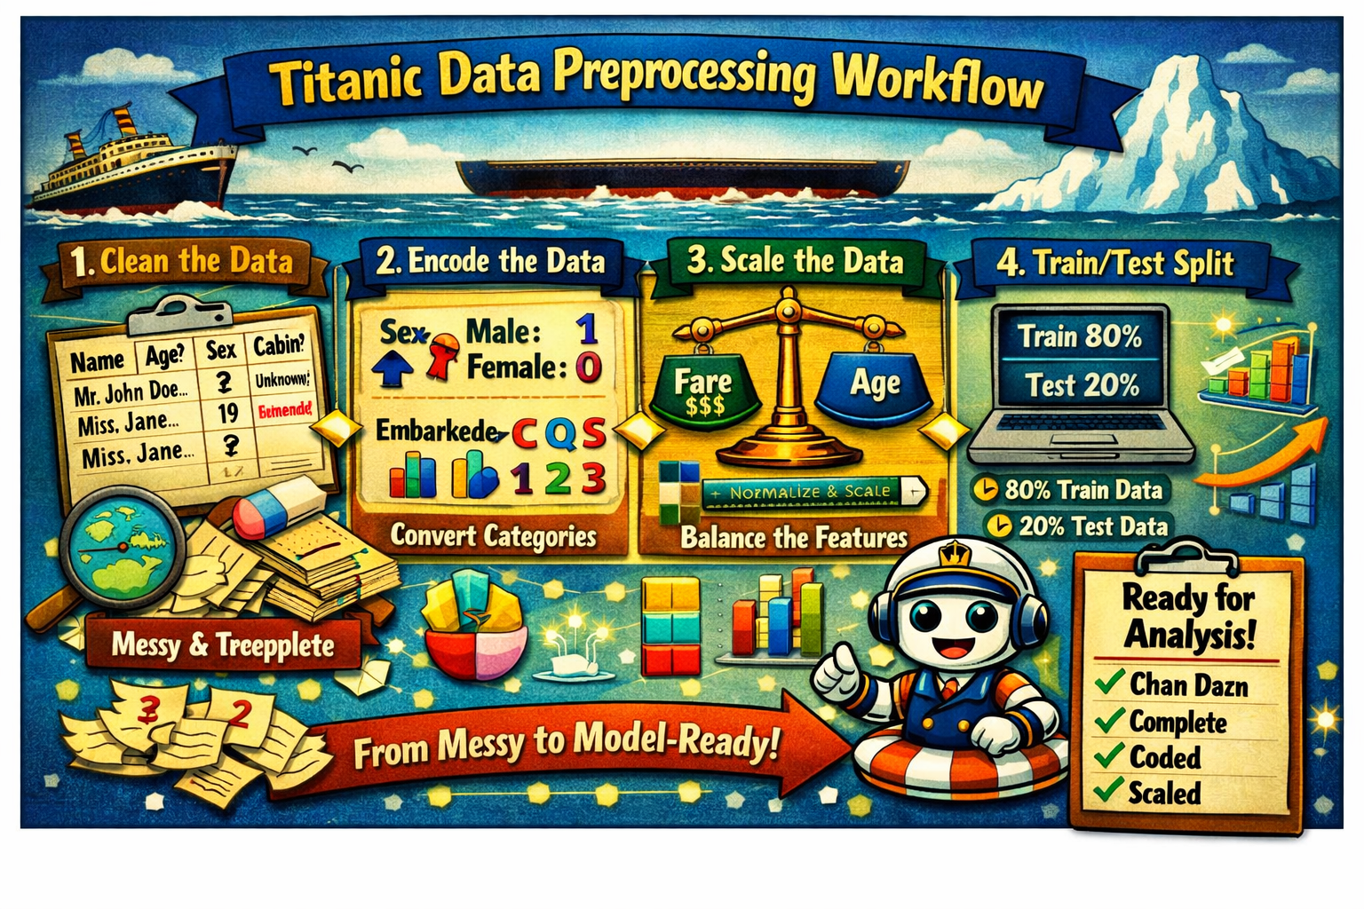

Slide 24
# Step 1: Import libraries
import pandas as pd
from sklearn.preprocessing import LabelEncoder, StandardScaler
from sklearn.model_selection import train_test_split
# Step 2: Load the dataset
titanic = pd.read_csv("titanic.csv")
# Step 3: Clean the data
titanic['Age'].fillna(titanic['Age'].median(), inplace=True) # Fill missing ages
titanic.drop(columns=['Cabin'], inplace=True) # Drop Cabin column
titanic.dropna(subset=['Embarked'], inplace=True) # Remove rows with missing Embarked
# Step 4: Encode categorical data
label_sex = LabelEncoder()
titanic['Sex'] = label_sex.fit_transform(titanic['Sex']) # Male=1, Female=0
label_embarked = LabelEncoder()
titanic['Embarked'] = label_embarked.fit_transform(titanic['Embarked']) # C/Q/S → 0/1/2
# Step 5: Scale numerical features
scaler = StandardScaler()
titanic[['Age', 'Fare']] = scaler.fit_transform(titanic[['Age', 'Fare']])
# Step 6: Train/Test Split
X = titanic[['Pclass', 'Sex', 'Age', 'Fare', 'Embarked']]
y = titanic['Survived']
X_train, X_test, y_train, y_test = train_test_split(X, y, test_size=0.2, random_state=42)
print("Training set shape:", X_train.shape)
print("Testing set shape:", X_test.shape)

Slide 25
Introduction — What Is Regression?
Regression is the process of finding relationships between variables — it helps us predict outcomes based on input data.
Goal: Estimate how one variable changes with another.
Example: Predicting Fare from Age and Class in the Titanic dataset.
Core Idea: Regression draws a line (or curve) through data points to model trends.
Analogy: Regression is like drawing a best‑fit line through scattered stars — it helps us see the pattern hidden in the noise.

Slide 26
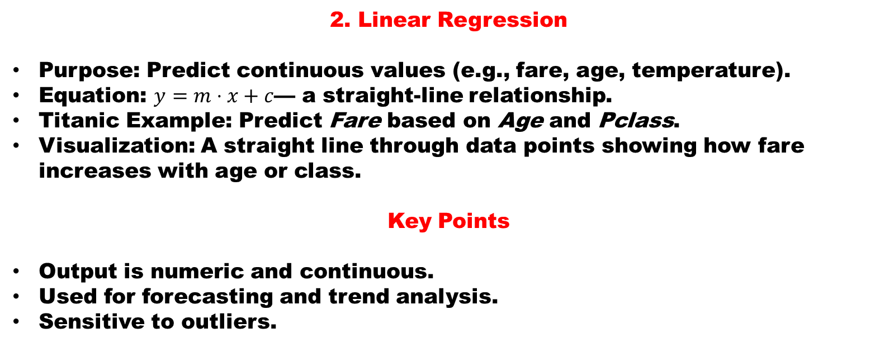
2. Linear Regression
Purpose: Predict continuous values (e.g., fare, age, temperature).
Equation: $y=m⋅x+c$— a straight‑line relationship.
Titanic Example: Predict Fare based on Age and Pclass.
Visualization: A straight line through data points showing how fare increases with age or class.
Key Points
Output is numeric and continuous.
Used for forecasting and trend analysis.
Sensitive to outliers.

Slide 27
3. Logistic Regression
Purpose: Predict categorical outcomes (e.g., survived = 1, not survived = 0).
Equation: Uses the sigmoid function to map predictions between 0 and 1.
Titanic Example: Predict Survival based on Age, Sex, Fare, Pclass.
Visualization: S‑shaped curve separating survivors from non‑survivors.
Key Points
Output is probability (0 ≤ p ≤ 1).
Used for classification tasks.
Converts probabilities into categories.

Slide 28
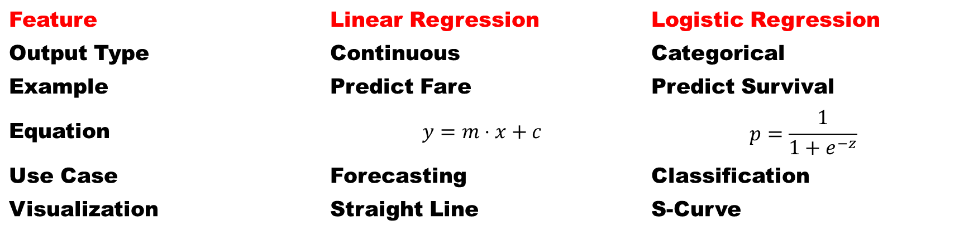
4. Comparison Summary
Feature | Linear Regression | Logistic Regression
Output Type | Continuous | Categorical
Example | Predict Fare | Predict Survival
Equation | $$y=m⋅x+c$$ | $$p=\frac{1}{1+e^{−z}}$$
Use Case | Forecasting | Classification
Visualization | Straight Line | S‑Curve

Slide 29
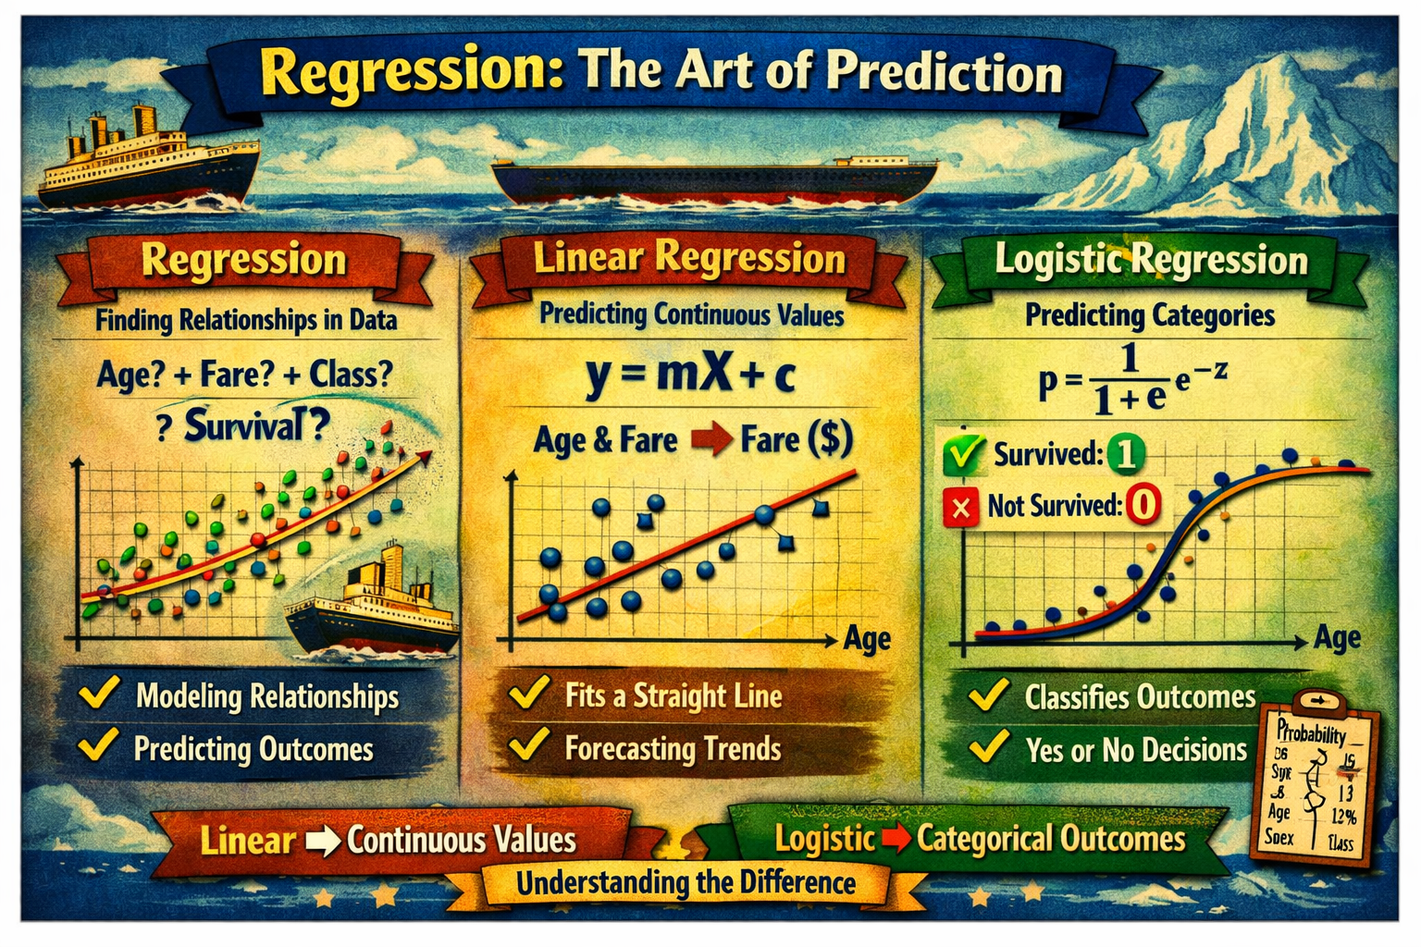

Slide 30
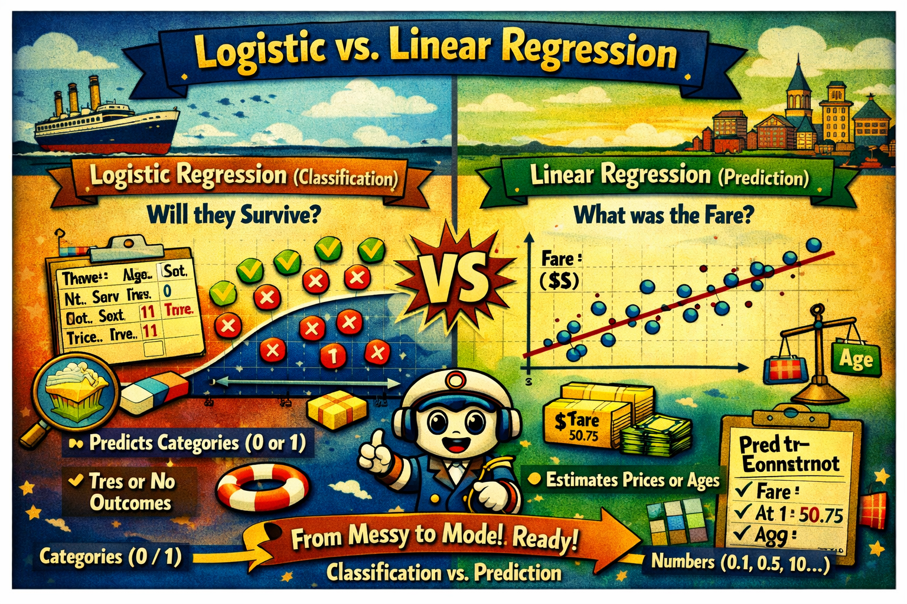

Slide 31
Data preprocessing forms the backbone of every machine‑learning project. It transforms raw, inconsistent data into a structured, reliable foundation for analysis. In the Titanic dataset, this meant cleaning missing values, encoding categorical variables like Sex and Embarked, scaling numerical features such as Age and Fare, and splitting the data for training and testing. These steps ensure that the model learns from meaningful patterns rather than noise, setting the stage for accurate predictions.
Once the data is prepared, regression becomes the natural next step — the mathematical lens through which relationships between variables are revealed. Regression helps us understand how one factor influences another: how Age or Class might affect Fare, or how Sex and Pclass contribute to Survival. It is the bridge between data preparation and intelligent inference, turning cleaned numbers into insights.
Linear regression, the simplest form, draws a straight line through data points to predict continuous outcomes — for instance, estimating Fare based on Age and Class. Logistic regression, on the other hand, bends that line into an S‑curve to classify outcomes such as Survived or Not Survived. Together, they illustrate how regression adapts to both numeric and categorical predictions, making it a versatile tool in data science.
In essence, today’s session has shown how preprocessing and regression complement each other: one prepares the data, the other extracts meaning from it. As we move forward, students will see that mastering these two stages — cleaning and modeling — is the key to unlocking the full potential of machine learning.

Slide 32
Together, these methods show us that machine learning isn’t magic — it’s logic built on preparation. Preprocessing gives the data its voice, and regression helps us listen to what it’s saying. When combined, they form the foundation of every predictive model we’ll build.
In our next class, we’ll dive deeper into linear regression analysis, exploring how to interpret coefficients, measure accuracy, and visualize predictions. For now, remember: clean data leads to clear insights — and regression is how we make those insights speak.

Slide 33


